Slide 1
Computer-Assisted Text Analysis for Social Sciences
Ryan Wesslen

Slide 2
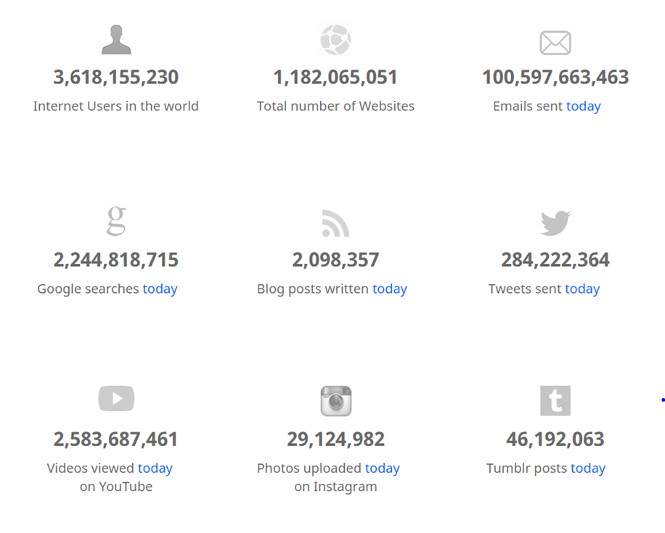
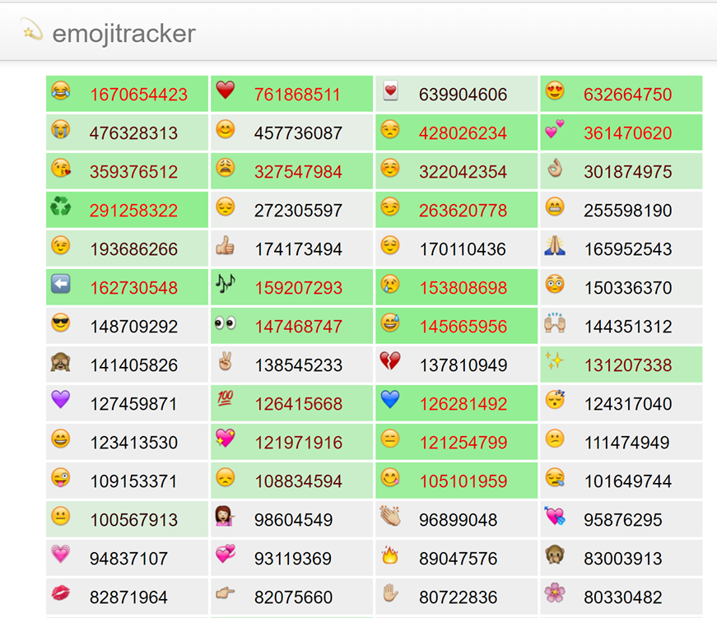
Words, words, words…
http://www.internetlivestats.com/
http://emojitracker.com/

Slide 3
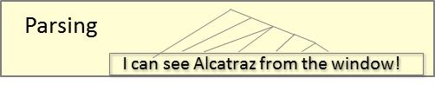
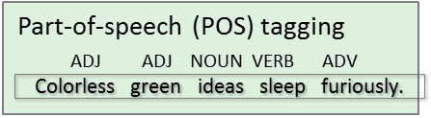
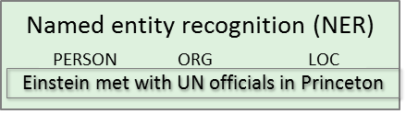
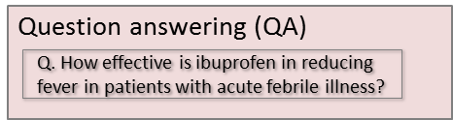
text analysis methods
Text Analysis
Qualitative Analysis (Human coding, Dictionaries)
Count-based (Bag-of-words, vector space)
Natural Language Processing
Supervised
Unsupervised
Topic Modeling
Overgeneralization for illustrative purposes (e.g., omits word embedding, deep learning)
NLP Graphics by Dan Jurafsky

Slide 4
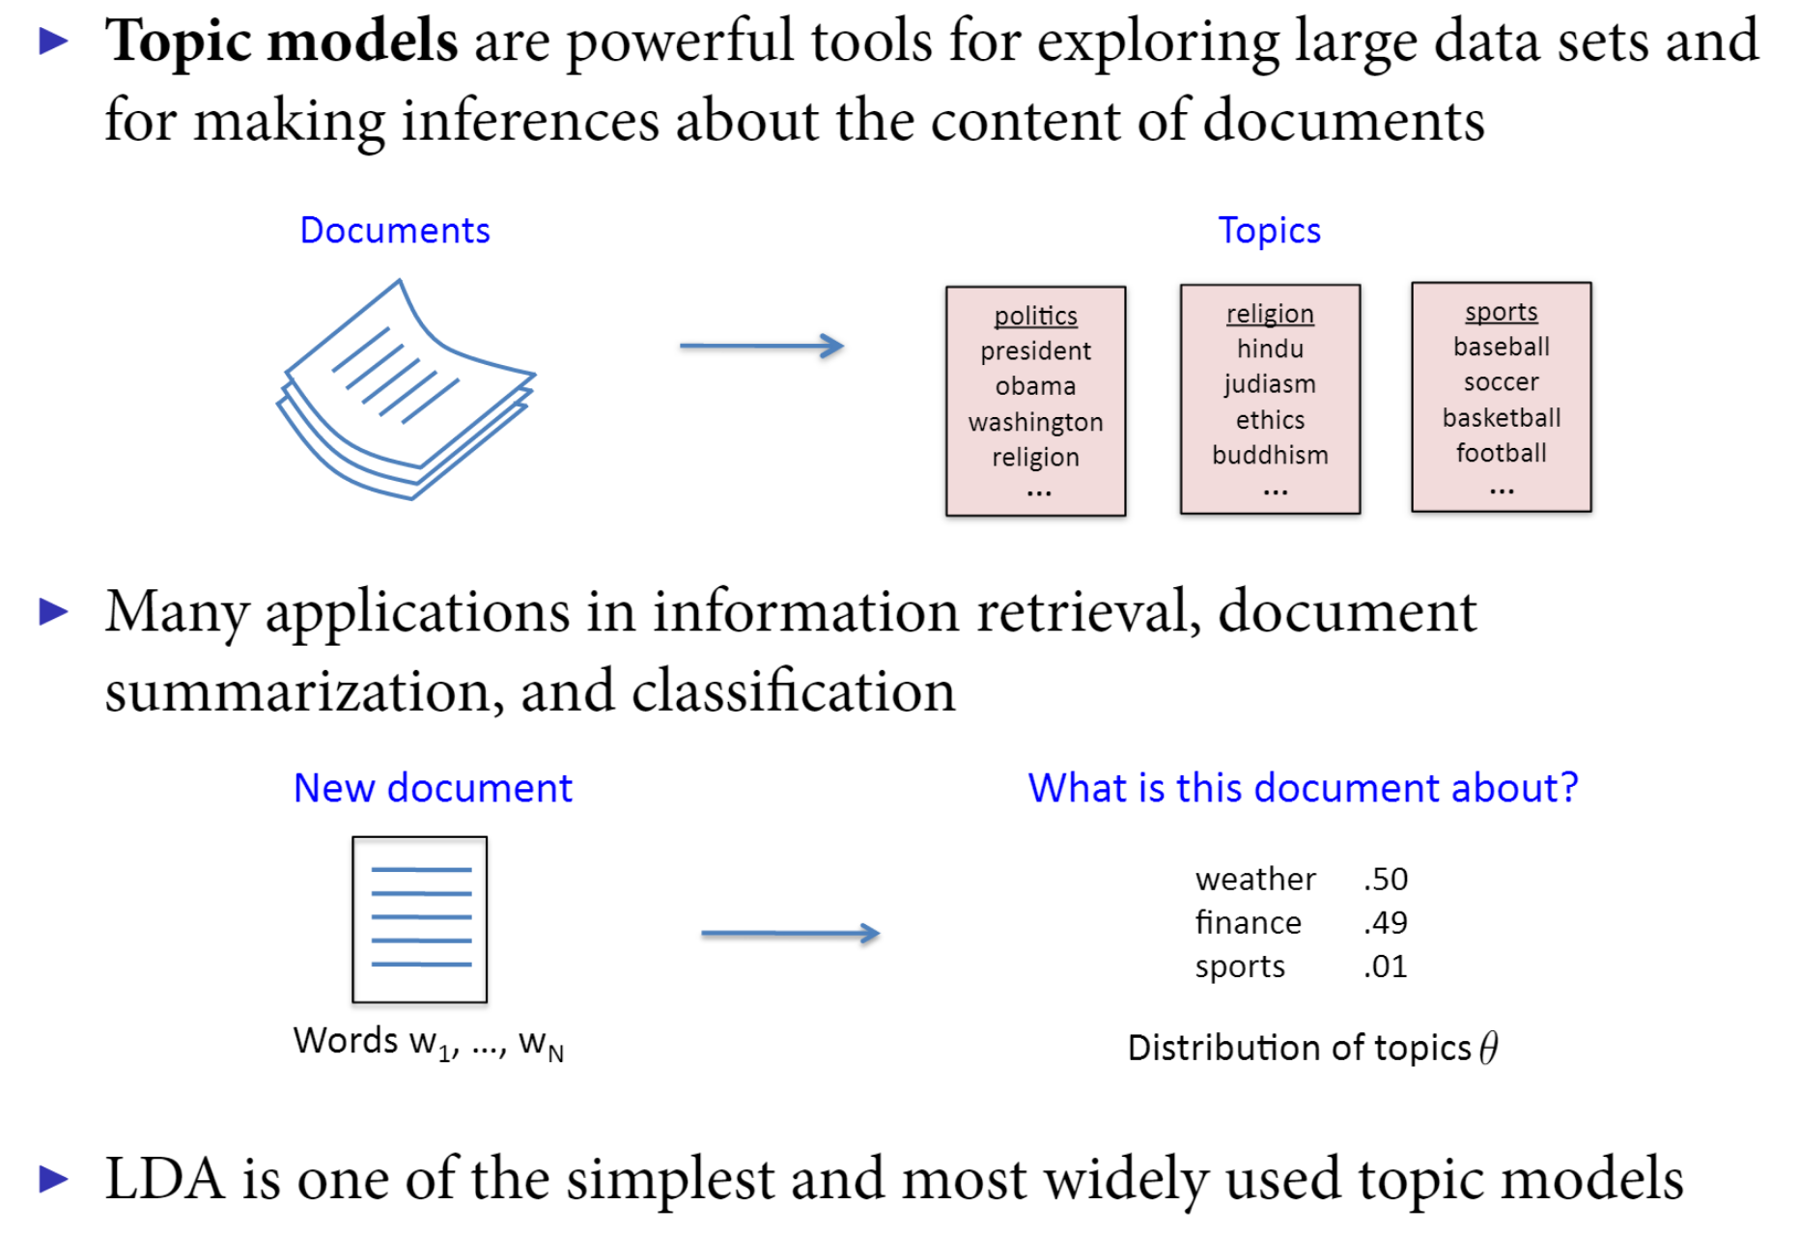
Intuition of Topic modeling
Pablo Barberá

Slide 5
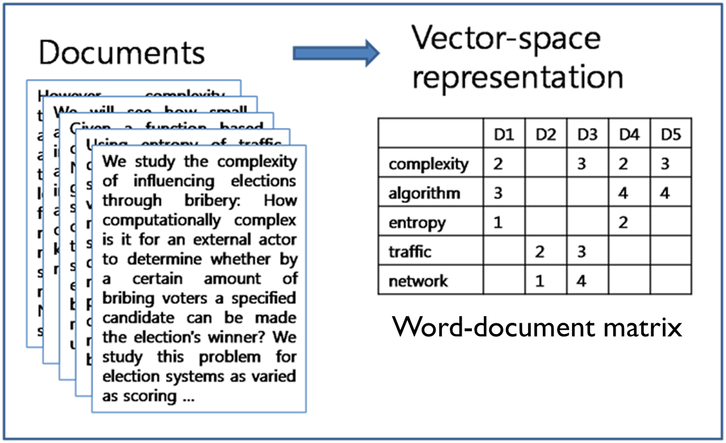
Count-based: Bag of words assumption

Slide 6
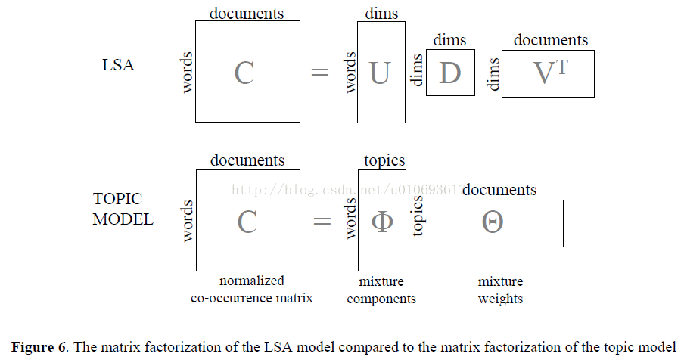
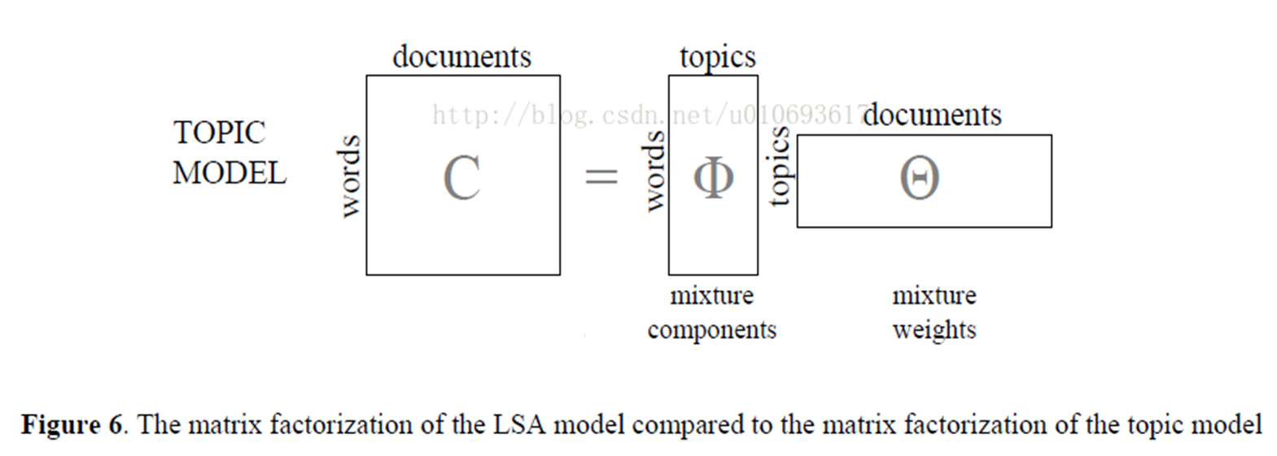
LSA & LDA: matrix factorization

Slide 7
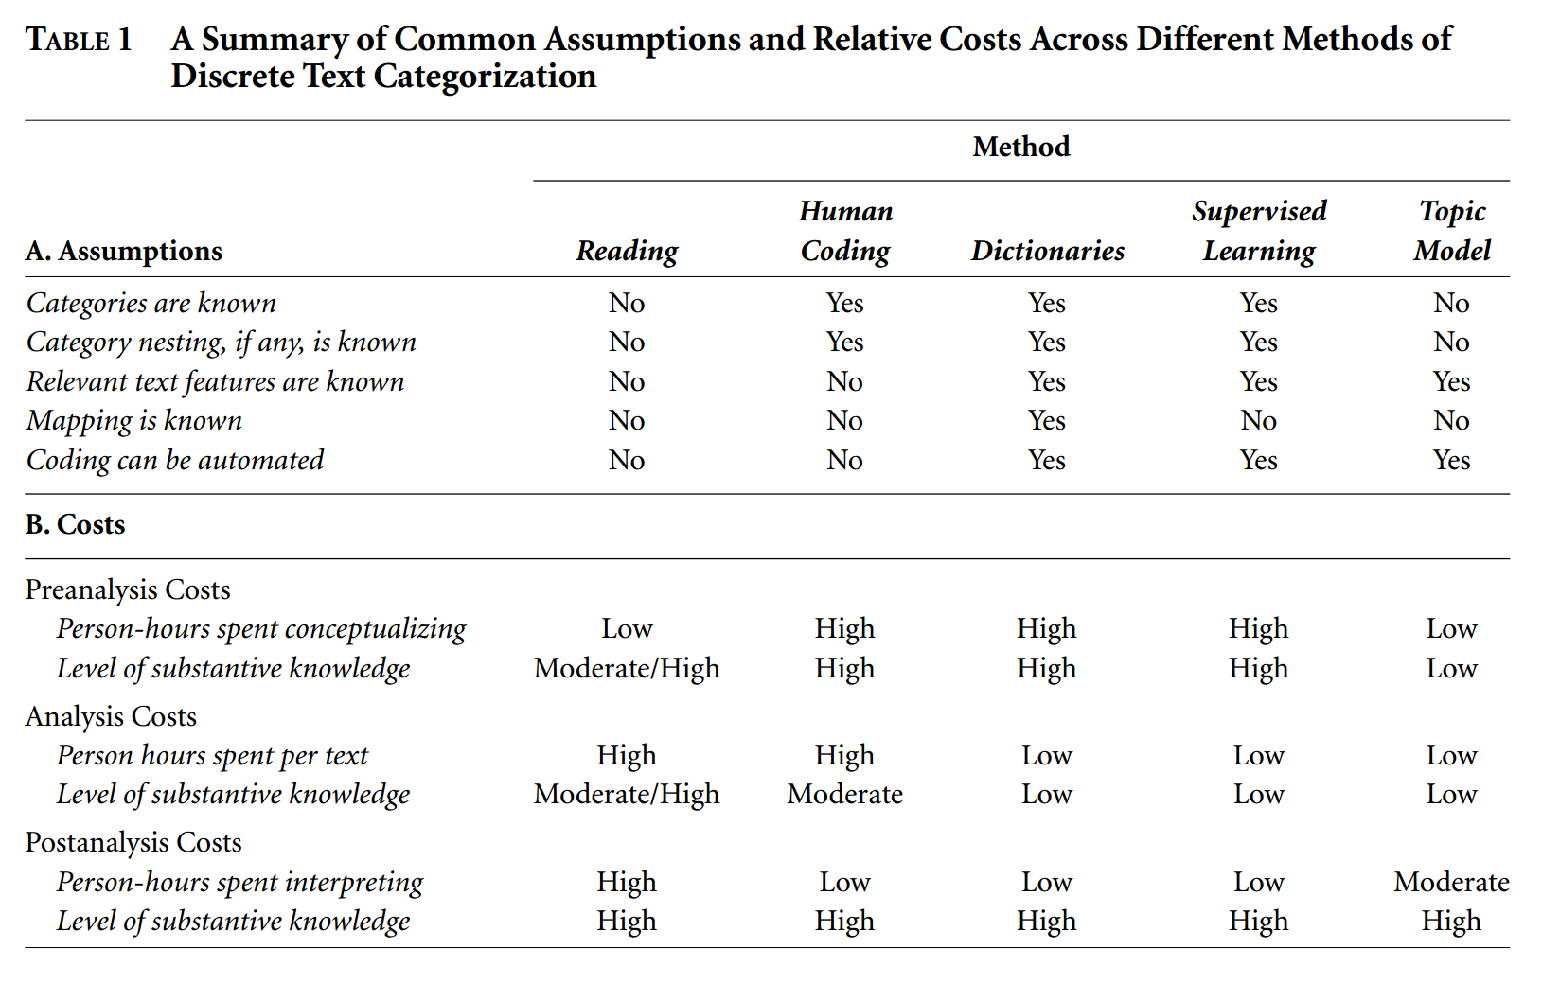
Text analysis for social scientists
Topic Models have low pre/analysis costs, but can take time/effort to interpret...
Need for visualizations!
Quinn et al. (2010)

Slide 8
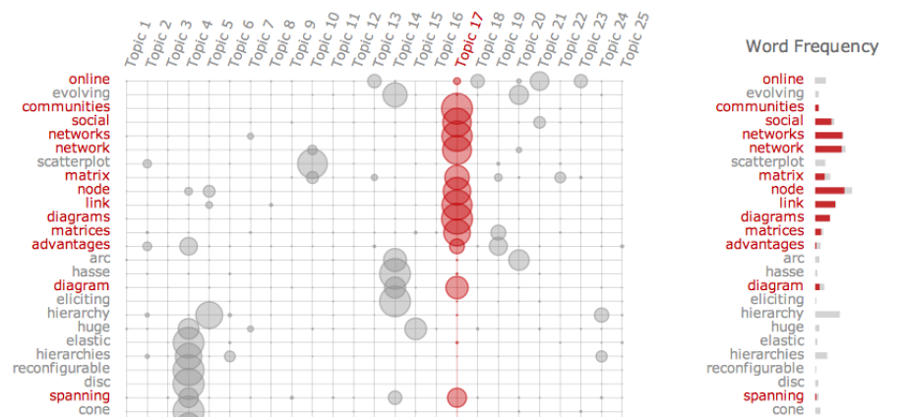
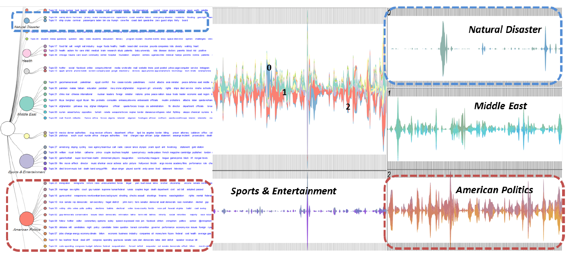
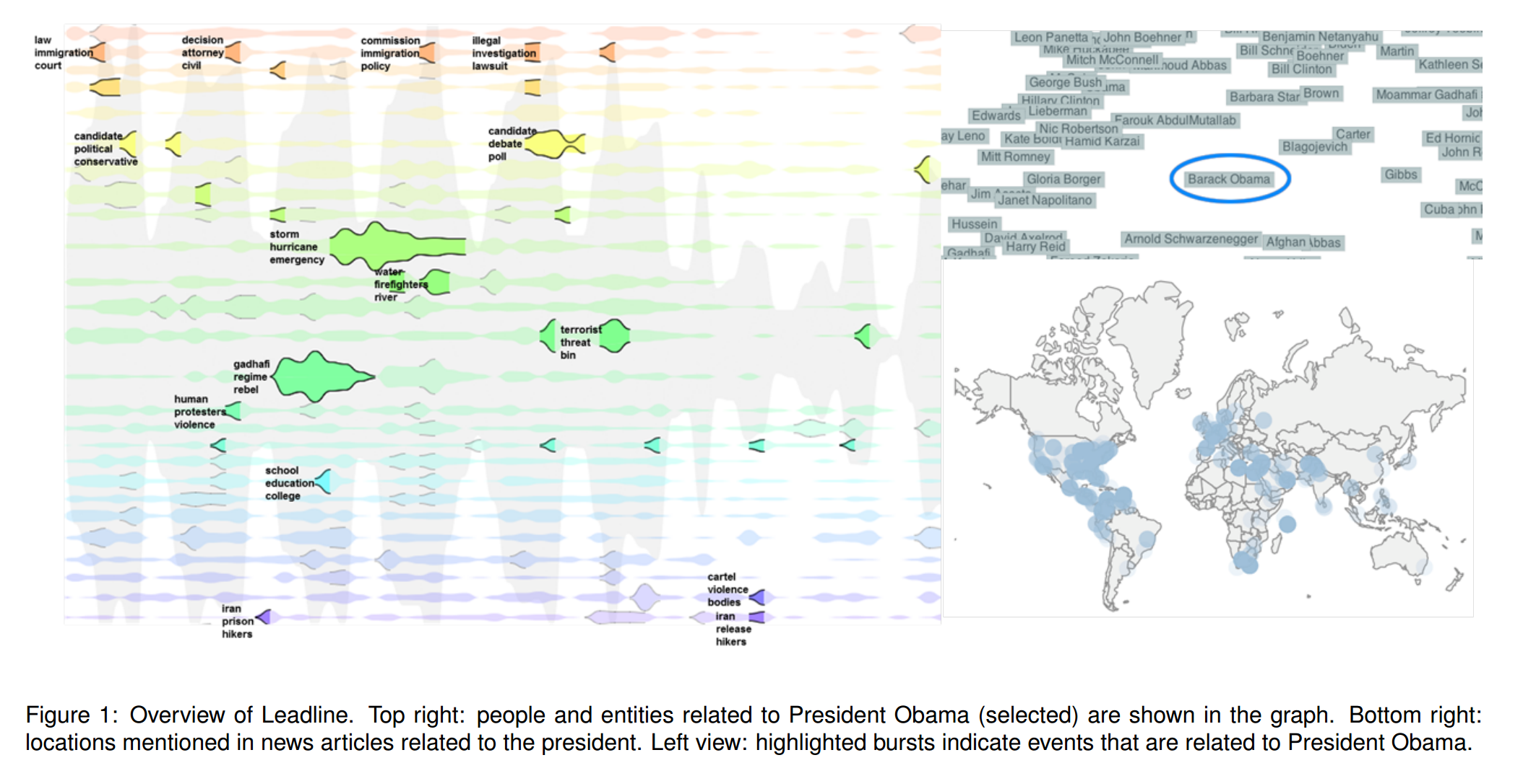
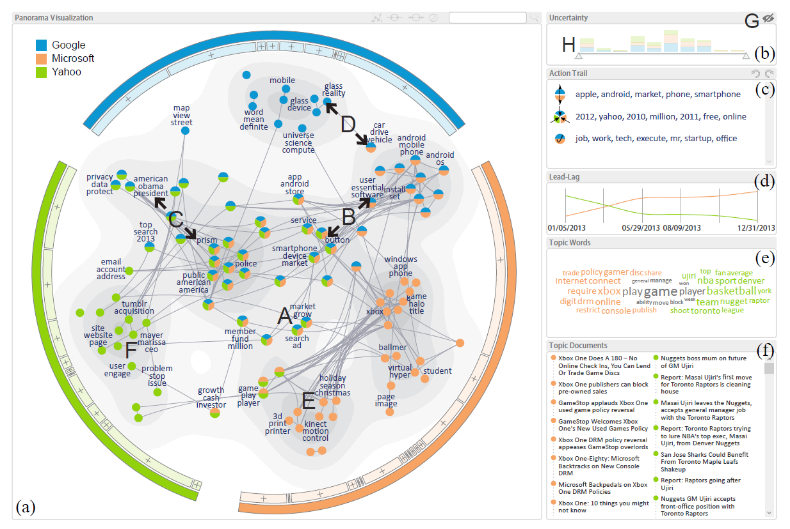
Topic-oriented: chuang et al. (2012)
Hierarchical: dou et al. (2011)
Time oriented: dou et al. (2012)
network based: wang et al. (2016)

Slide 9
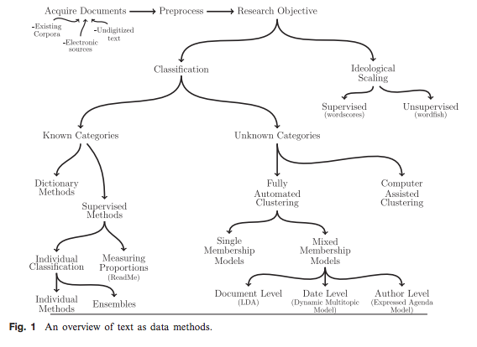
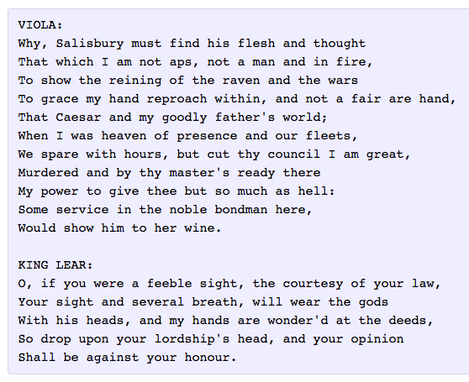
tip of the iceberg
Recent Advances
Word Embedding (Word2Vec, GloVe)
Deep Learning (RNN/LSTM)
Grimmer & Stewart (2013)
Karpathy (2015)

Slide 10
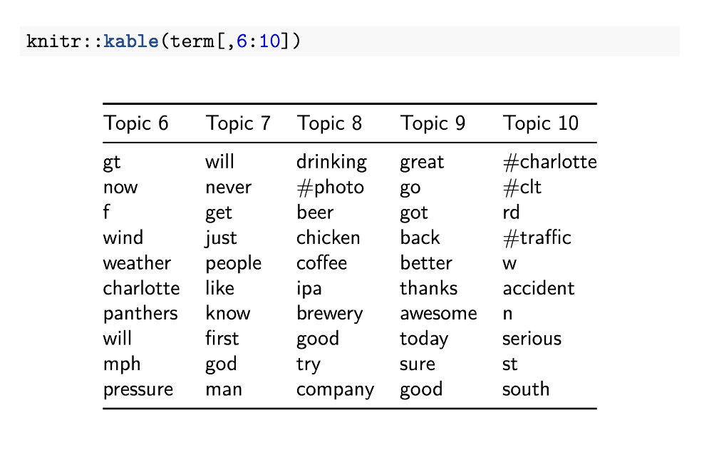
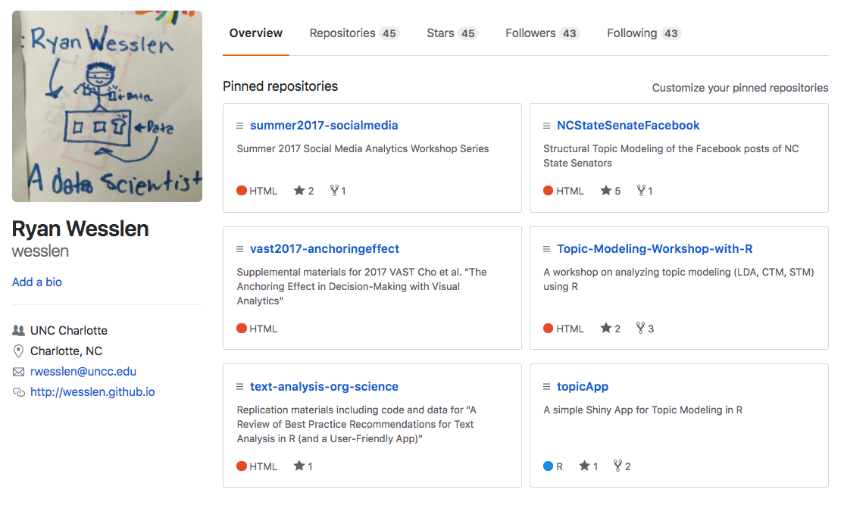
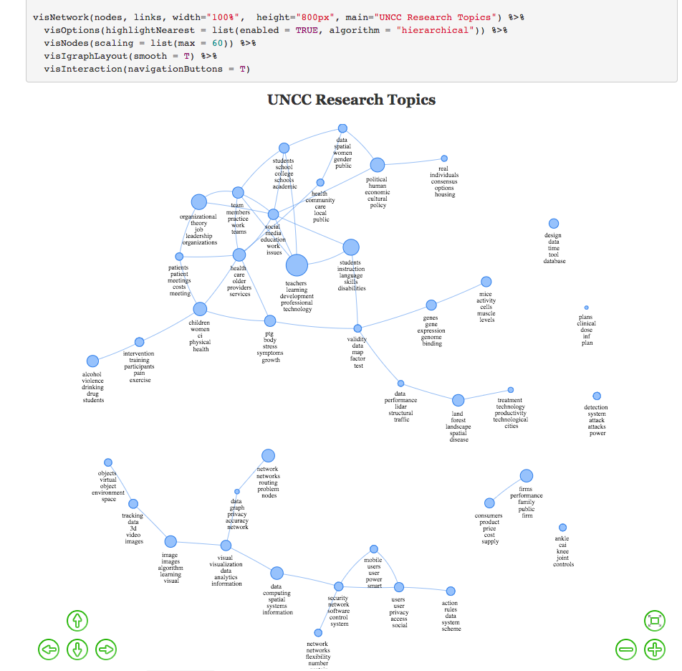
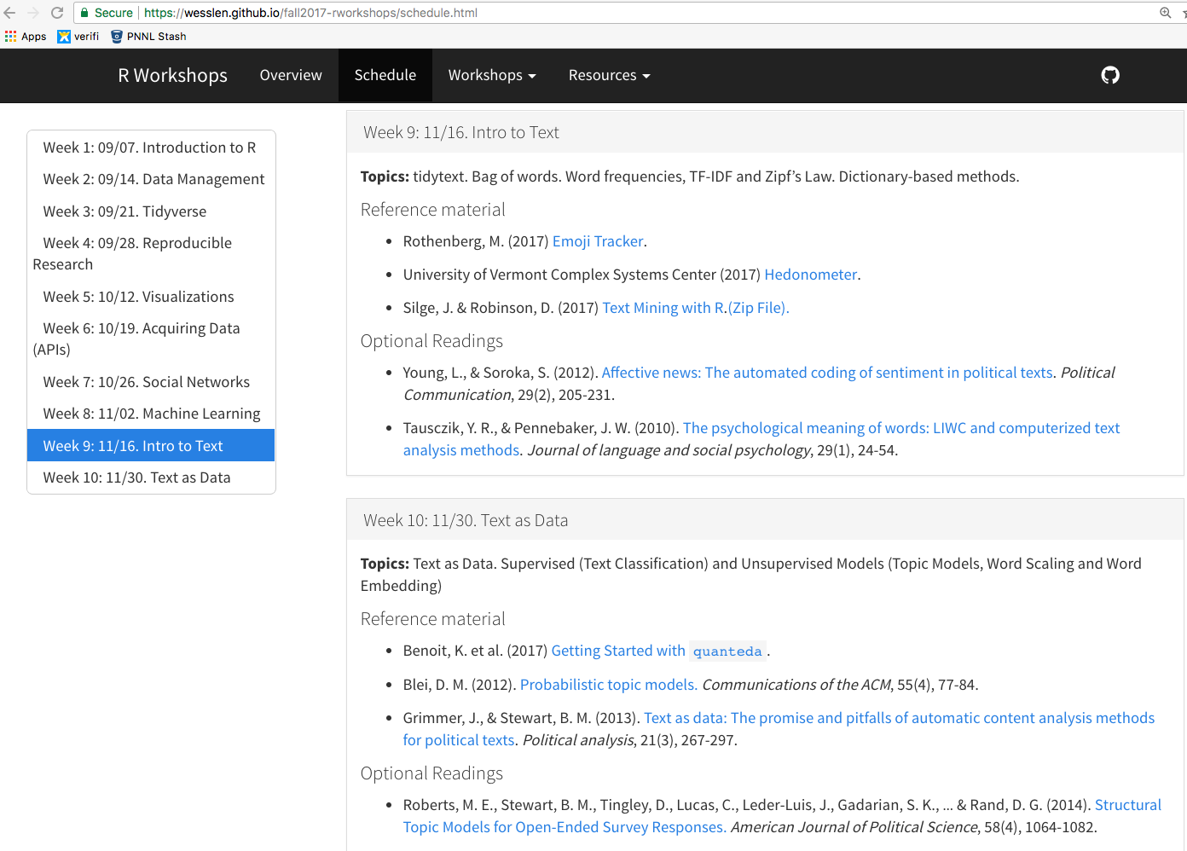
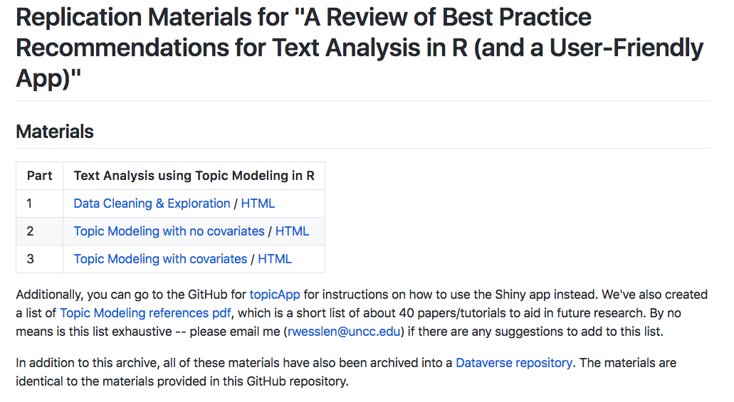
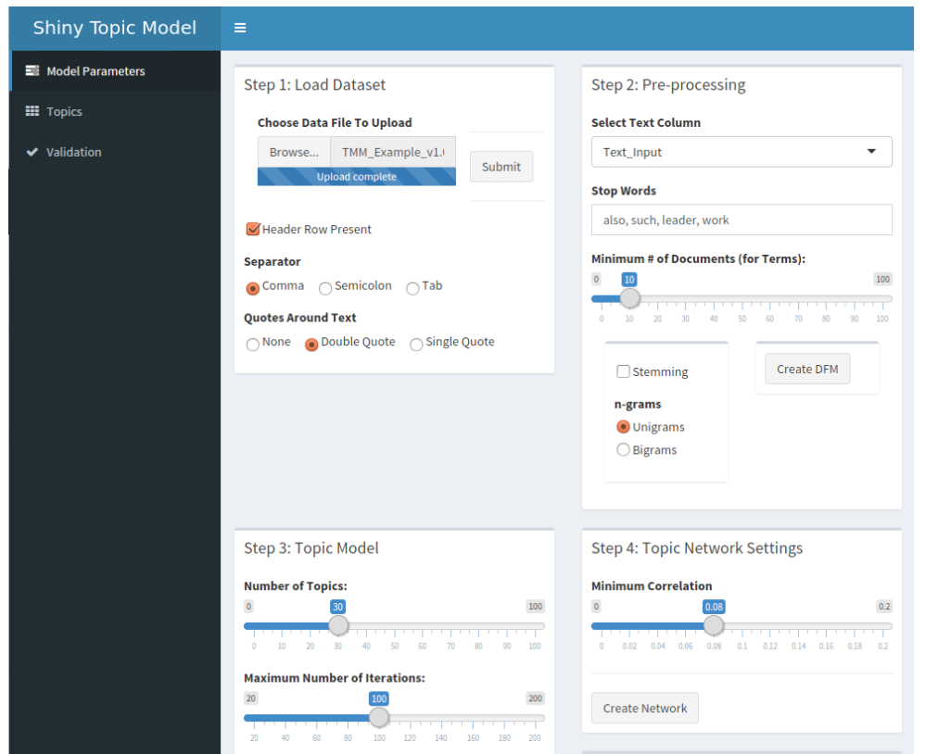
helpful Materials & code
https://github.com/wesslen
https://wesslen.github.io/fall2017-rworkshops/

